Slide 1





dabl
Automatic ML with a human in the loop
Andreas Müller
Associate Research Scientist
Columbia University
Scikit-learn Technical Committee
Notes:
Hi, I’m Andreas Mueller. I’m grateful for the opportunity to talk to you today about my work here at the DSI, and about Open Source for Science and Data Science.
I’m an Associate Research Scientist, and I mostly work on open source software for machine learning, in particular the scikit-learn library.
My talk will have two parts: first, I want to talk a bit about the importance of software for science, and the scientific python ecosystem.
Then I’ll talk more about the particular project I’m working on, scikit-learn, and my group here at Columbia.

Slide 2
A real world ML workflow
Data Cleaning
Visualization
Model Building
Data Collection
Model Interpretation
Business evaluation

Slide 3
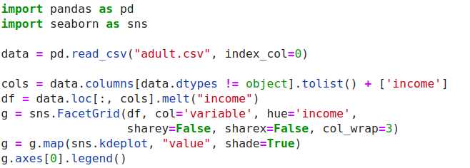
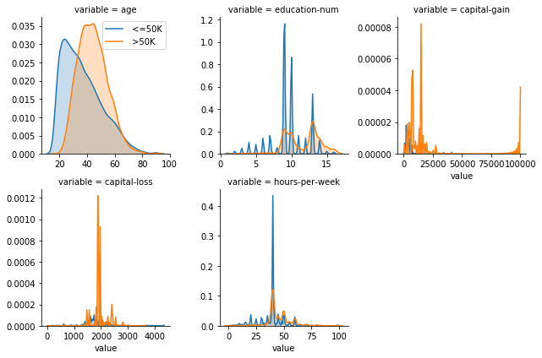
ML with sklearn & pandas

Slide 4
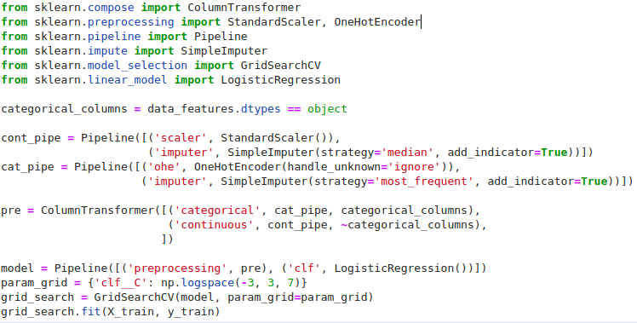
ML with sklearn & pandas

Slide 5
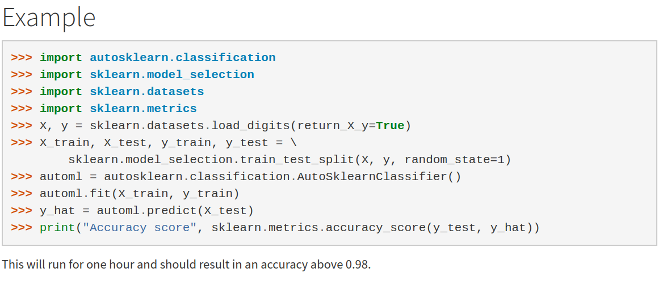
Current Automatic ML frameworks

Slide 6


Slide 7
data
analysis
baseline
library

Slide 8
dabl.clean
dabl.plot
Data Cleaning
Visualization
Model Building
Data Collection
dabl. AnyClassifier
Model Interpretation
Business evaluation
dabl.explain
You actually have to think, sorry.

Slide 9
Data cleaning
& preprocessing

Slide 10
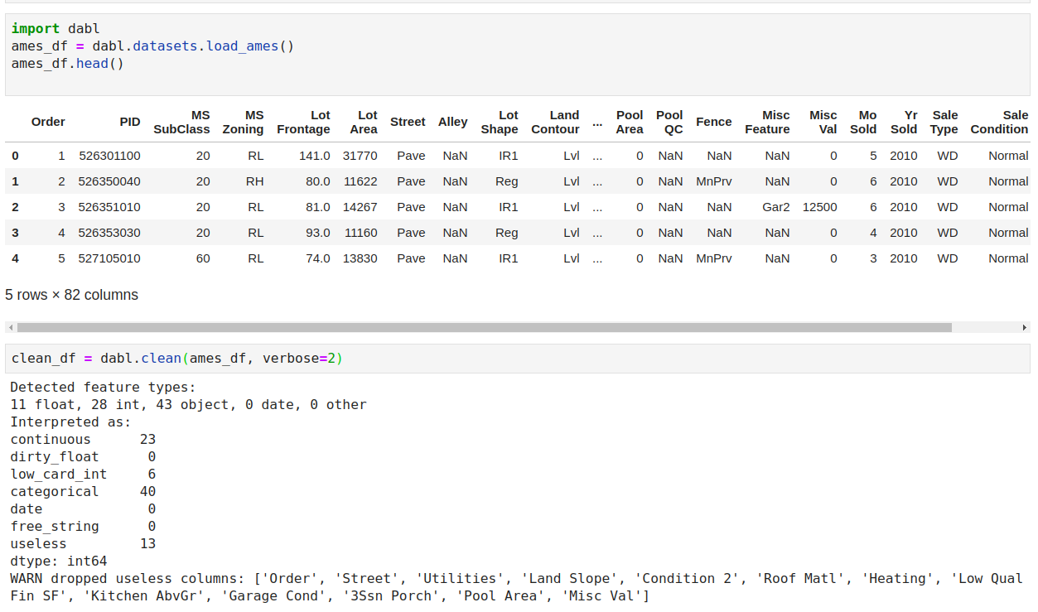

Slide 11
dabl.clean
Detect types (can overwrite)
Detect Missing / rare values
Detect ordinal vs categorical
Detect near-constant
Detect index

Slide 12
Visualization

Slide 13
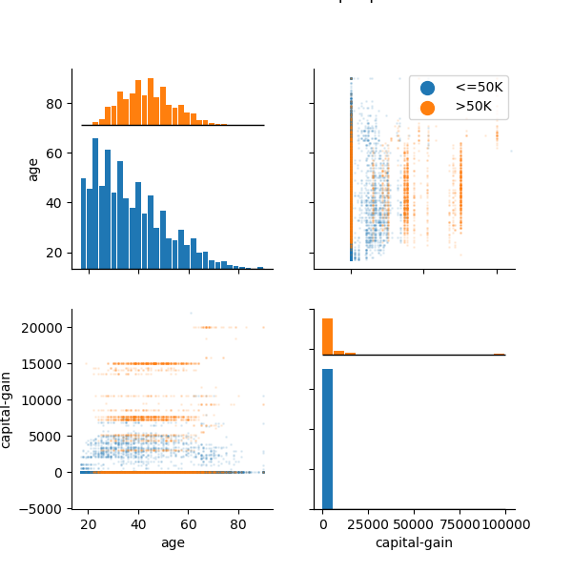
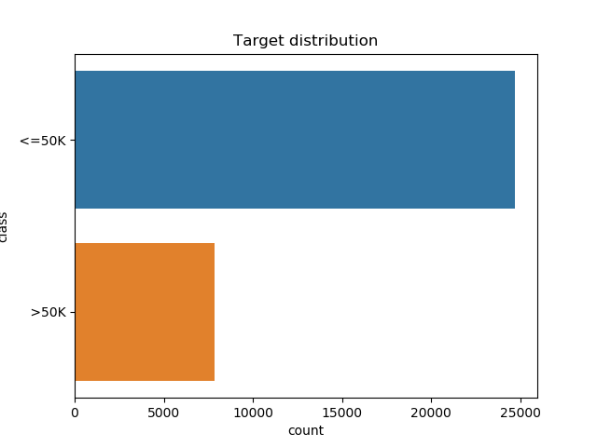
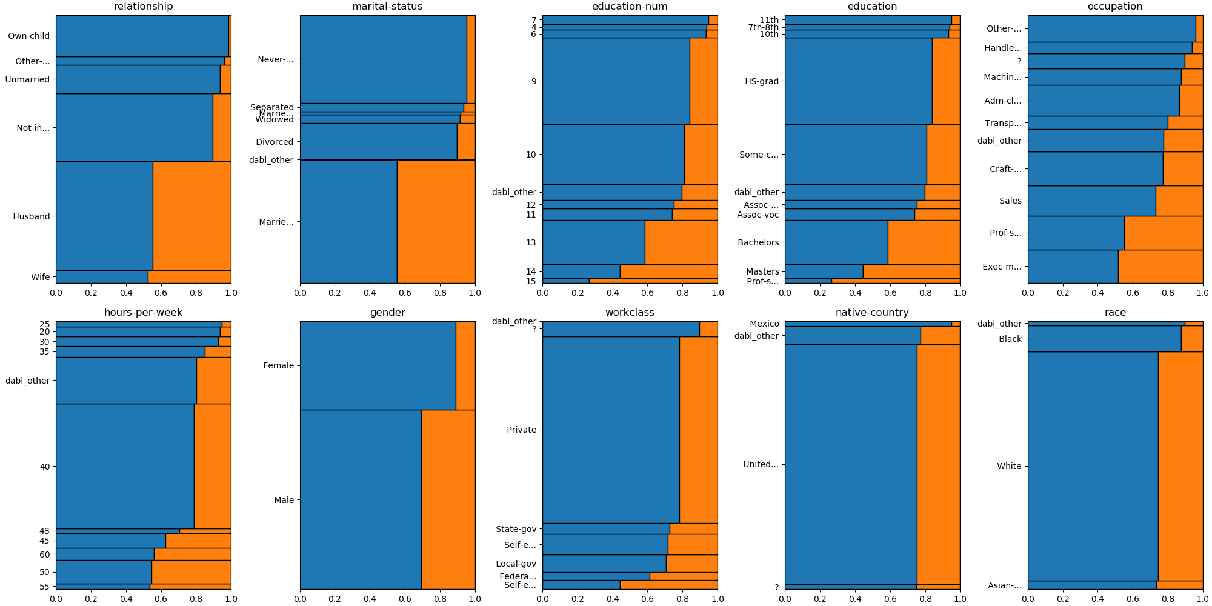
data = pd.read_csv("adult.csv", index_col=0)
plot(data, 'income', scatter_alpha=.1)

Slide 14
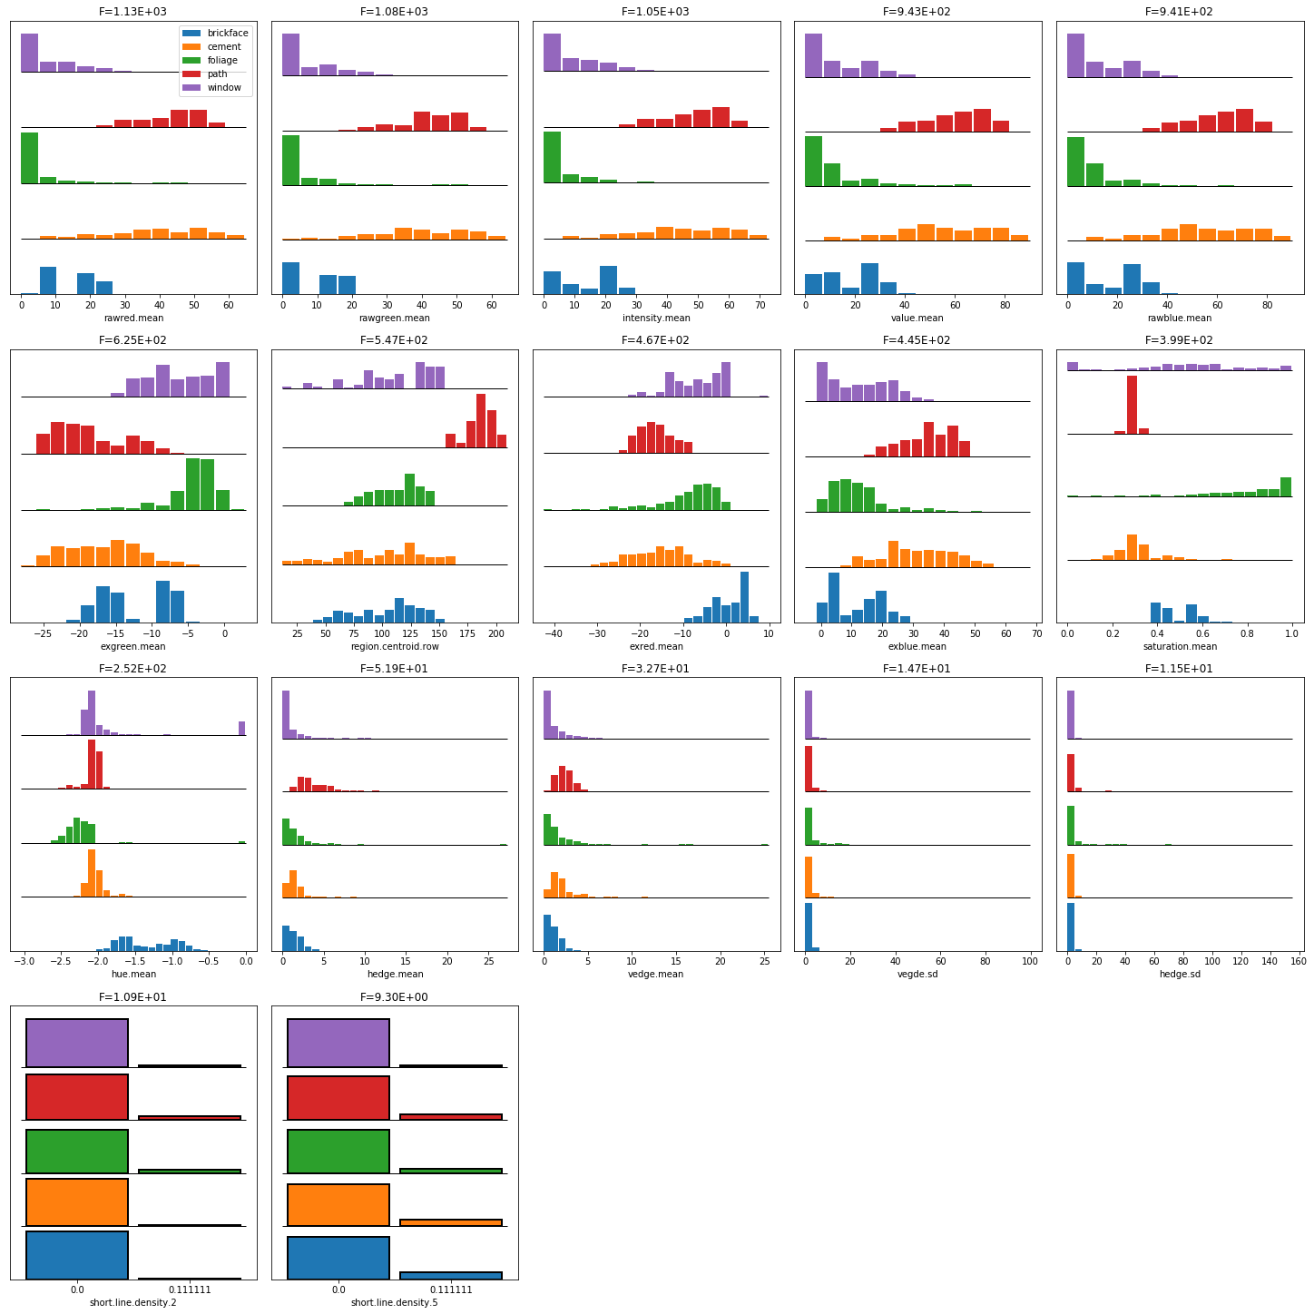
Univariate plots

Slide 15

Mosaic Plots

Slide 16
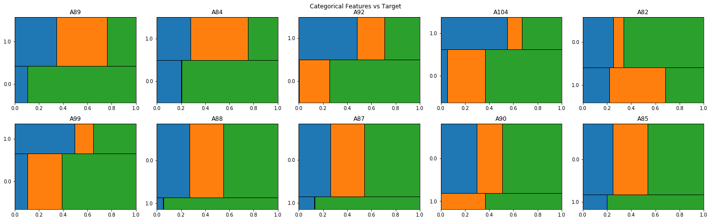
Mosaic Plots

Slide 17
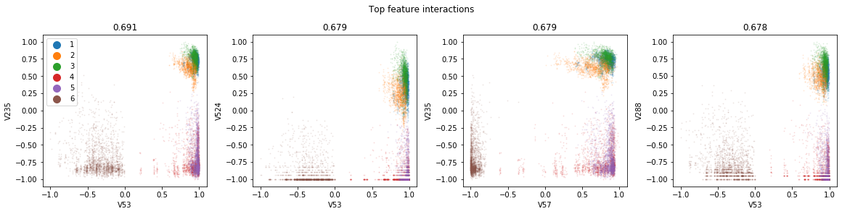
Pairwise Plots

Slide 18
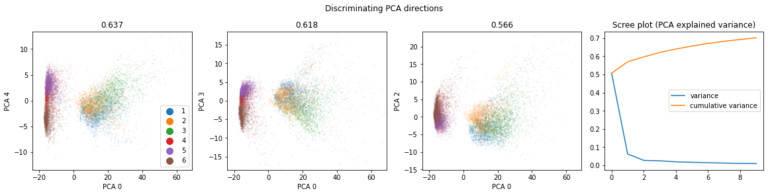
Principal Component Analysis

Slide 19
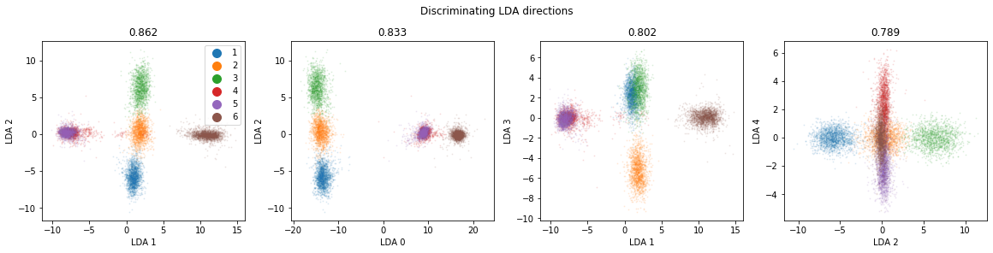
Linear Discriminant Analysis

Slide 20
A note on scatter plots?

Slide 21
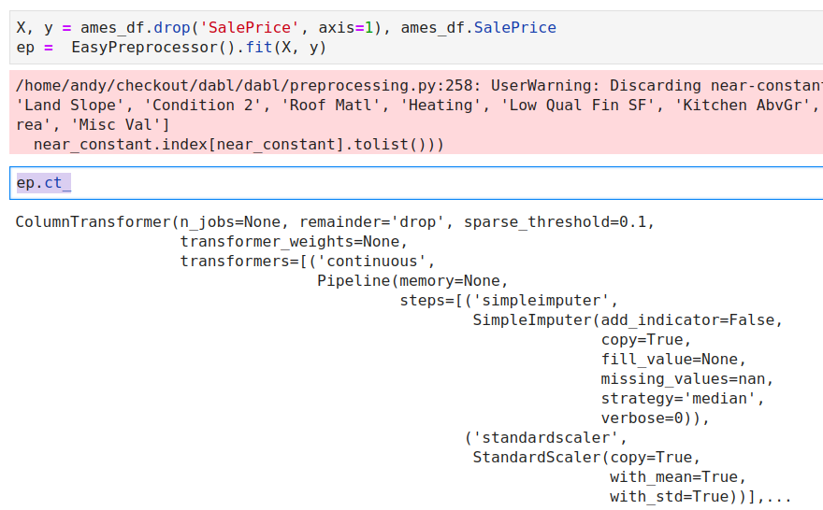
Preprocessing

Slide 22
Simple Prototypes

Slide 23

Dummy Models
Naive Bayes
Stumps
Linear Models

Slide 24
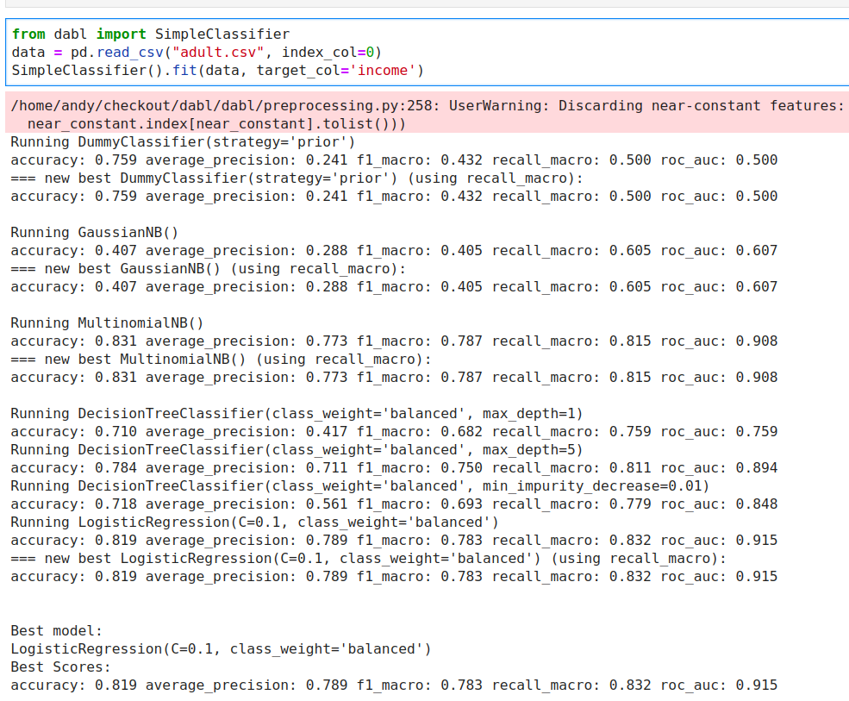
Either X, y
Or dataframe, target_col

Slide 25
Automatic Model Search

Slide 26

Complex Models
More Linear Models
Random forest
Gradient boosting
Kernel methods

Slide 27
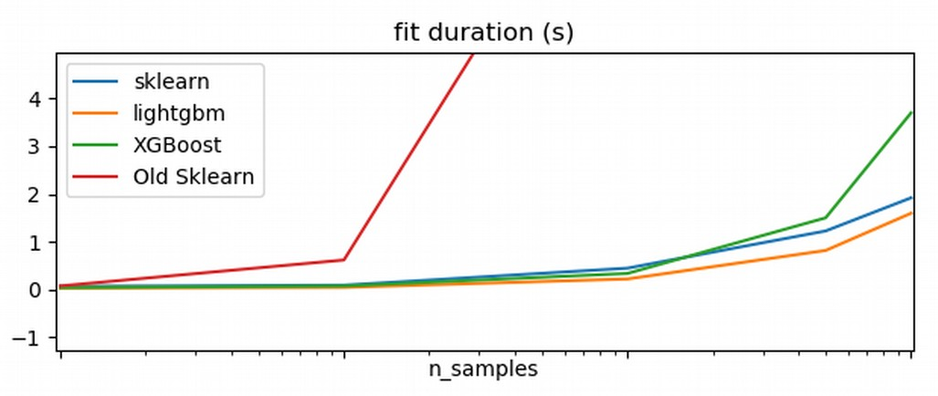

Side note: HistGradientBoosting

Slide 28
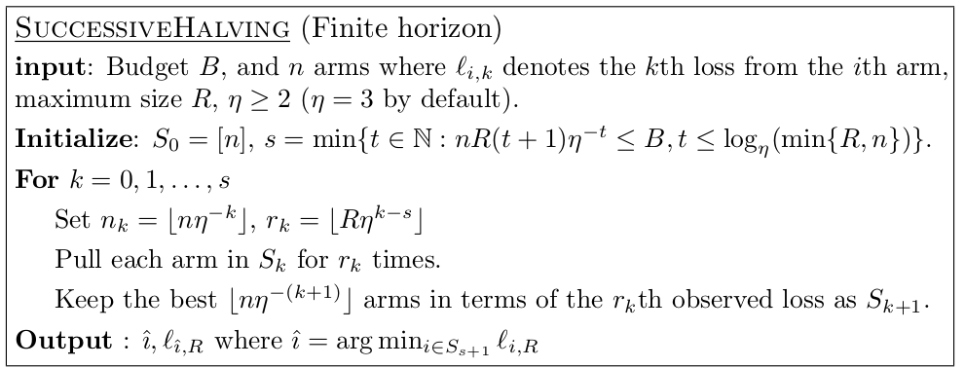
Successive Halving
Given n configuration and budget B
pick η=2 or η=3 (wording follows 2)
Each iteration, keep best halve of configurations
after k=logη(n)+1 left with single configuration.

Slide 29
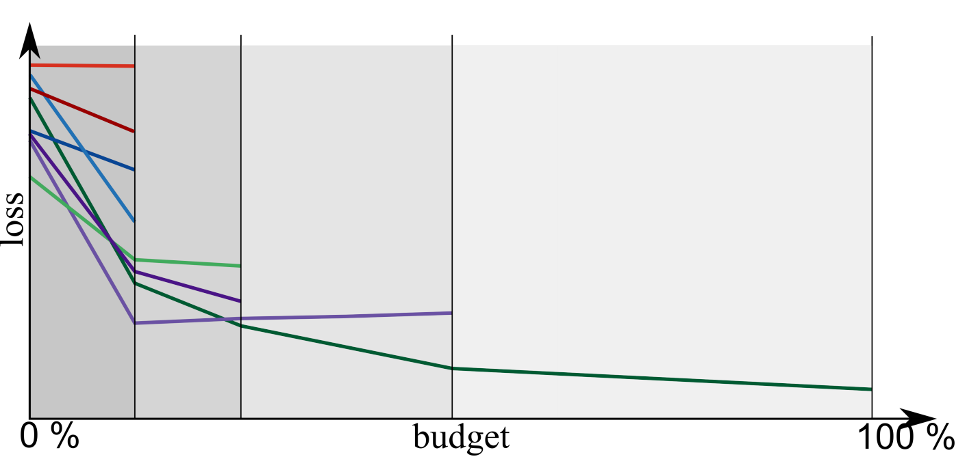
Successive Halving Illustrated

Slide 30
Portfolio creation
Run Hyper-parameter optimization across models on large benchmark suite (OpenML-CC18)
Evaluate all final models across all datasets
Greedily create portfolio of best-performing, diverse models
“Practical Automated Machine Learning
for the AutoML Challenge 2018” Feurer et. al.

Slide 31
Model Explanation

Slide 32
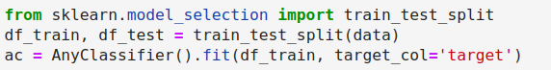
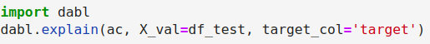

Slide 33
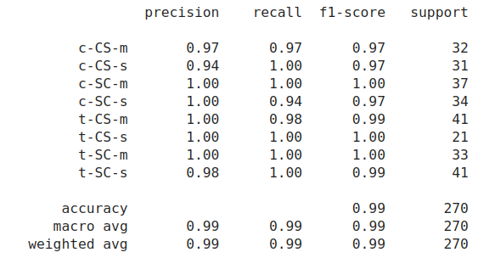
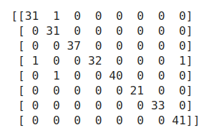
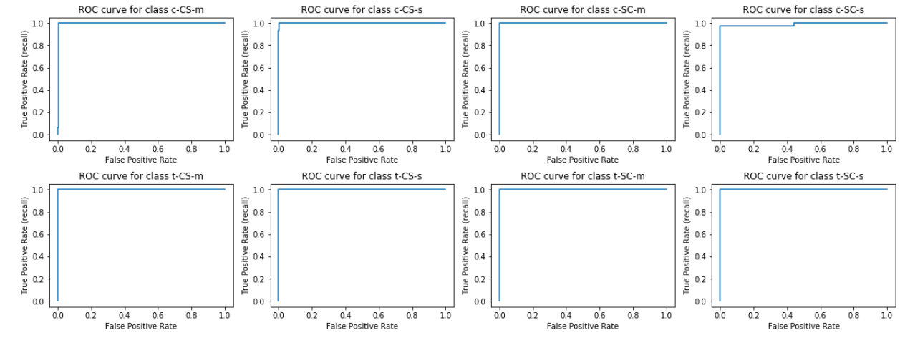
Metrics

Slide 34
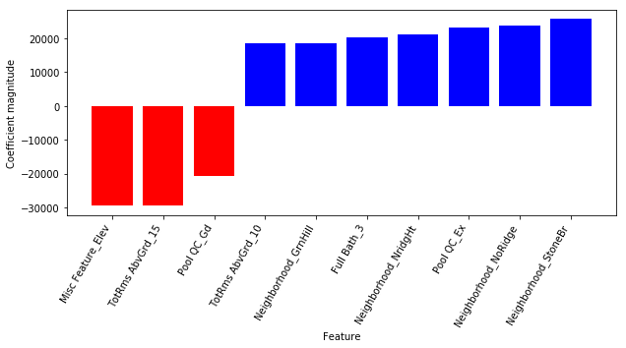
Coefficients / Feature importances

Slide 35
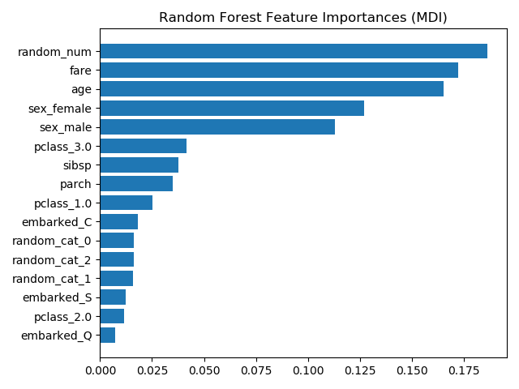
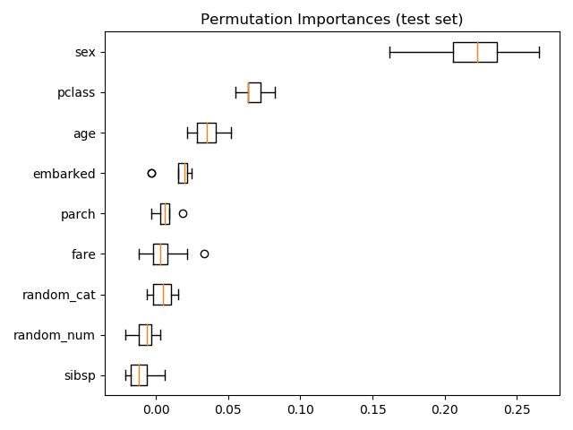
Permutation Importance
https://scikit-learn.org/dev/auto_examples/inspection/plot_permutation_importance.html

Slide 36
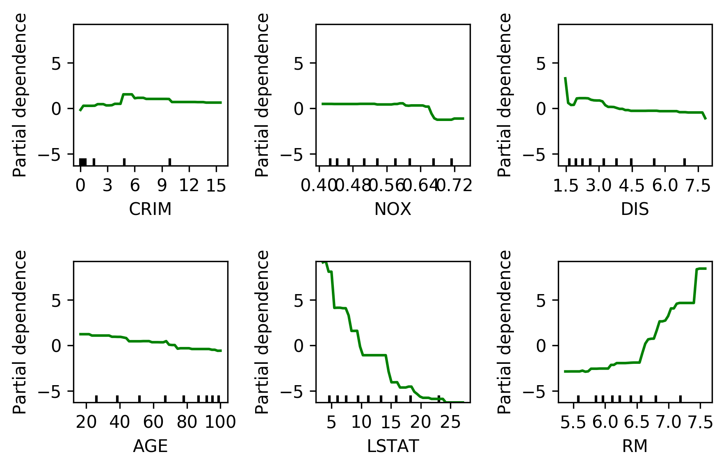
Partial Dependence Plots

Slide 37
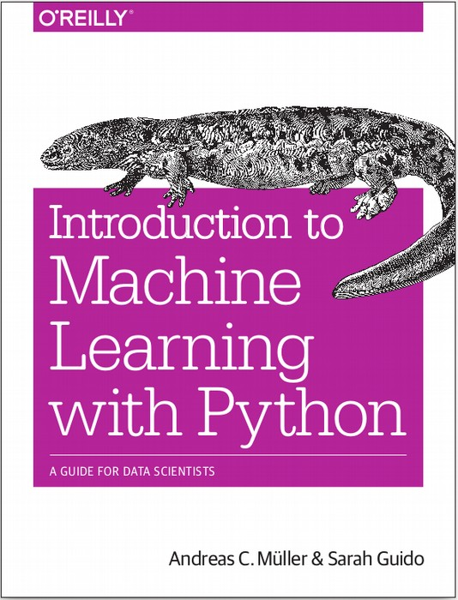




amueller.github.io
@amuellerml
@amueller
andreas.mueller
@columbia.com
Notes:
Thank you for your attention and I’m happy to take any questions!

